Slide 1

Supervised Learning
André Sousa (up202005277@fe.up.pt)
Gonçalo Pinto (up202004907@fe.up.pt)
Pedro Fonseca (up202008307@fe.up.pt)
AI Second Project

Slide 2
Specification of the work
Goal: Analyze and study the process of classification (data preprocessing, feature selection, model selection, model training and model evaluation). In this case, the goal is to use data collected from past records of an insurance company to predict whether a given client will file a claim in the next 6 months.
Project Objectives:
Given a data set, predict the target feature
Compare multiple machine learning models and feature selection to achieve the best results

Slide 3
Software used and related work
Stuart Russell, Peter Norvig; Artificial intelligence. ISBN: 978-0-13-207148-2
Richard S. Sutton; Reinforcement learning. ISBN: 978-0-262-03924-6
Stuart Russel, Peter Norvig; Artificial Intelligence: A modern Approach.
Exercise5 IART SupervisedLearning
Other approaches to the problem

Slide 4
Tools and algorithms
PyCharm Professional
Python 3.9
Git
Python packages:
scikit-learn
Pandas
Seaborn
Matplotlib
Machine Learning models:
Decision Tree
Neural Network (MLP)
k-nearest neighbors (KNN)
Support Vector Machine (SVM)

Slide 5
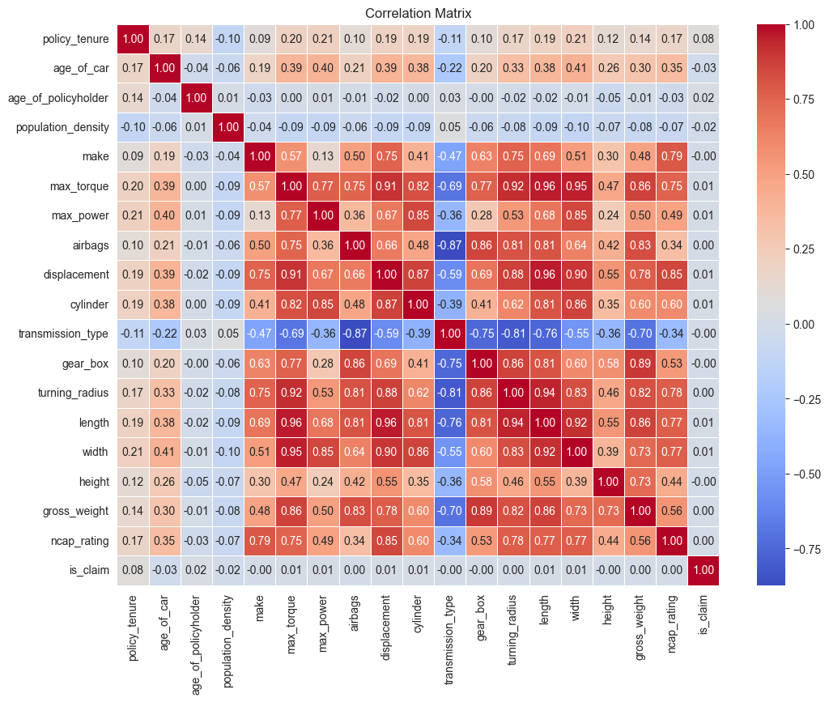
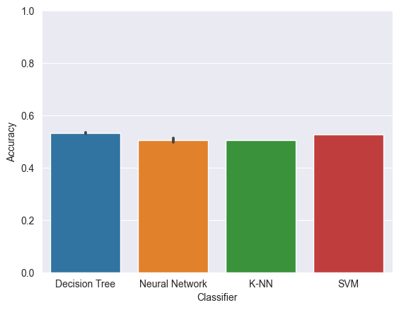
Implementation work already carried out
Data preprocess
Correlation analysis
Feature selection (based on correlation results)
Initial algorithm comparison

Slide 6
Data Preprocessing
Balancing the Dataset
Ensure equal representation of each target column value by creating a balanced dataset.
Transforming Nonnumeric Columns
Convert nonnumeric columns into numeric ones for compatibility with machine learning models.
Utilize techniques such as one-hot encoding, label encoding and string slicing.
Removing Redundancy from the Dataset
Identification and removal of columns with high correlation values to eliminate redundancy.
Test different correlation thresholds (0.70, 0.80, 0.90) to determine the optimal level of removal.
Creation of a dataset without columns that show no correlation with the target column.
Creating Combinations of Features
Introduction of a new column representing a numerical combination of three other columns.
Selection of columns with higher correlation to the target column for creating the combined feature.
Enhancement of the dataset with additional information for improved model performance.
Scaling and Adding Features
Application of feature scaling using the StandardScaler module to ensure consistent ranges for numeric features.
Usage of the PolynomialFeatures module to generate polynomial combinations of existing features.
Enhancement of the dataset by adding new features to capture non-linear relationships.

Slide 7
Developed models and comparison
We utilized four distinct machine learning models from scikit-learn for this task:
Tree: DecisionTreeClassifier
Neural Network: MLPClassifier
Neighbours: KNeighborsClassifier
Support Vector Machine: SVC
Stochastic Gradient Descent : SGD
Regarding the division of the dataset into training and testing sets, we employed two different methods:
Stratified K Folding
Random Division
We applied all the models to each dataset and assessed their performance by employing various metrics such as confusion matrices, accuracy, recall, F1 measure, and precision. Additionally, we utilized the GridSearchCV module to determine the optimal parameters for each model and dataset.

Slide 8
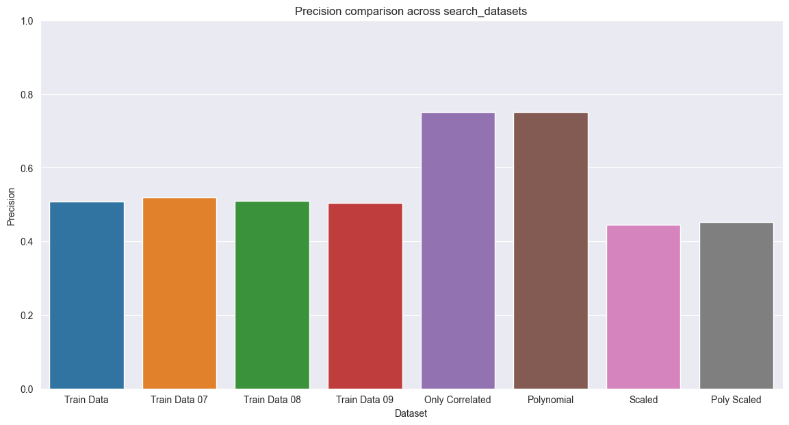
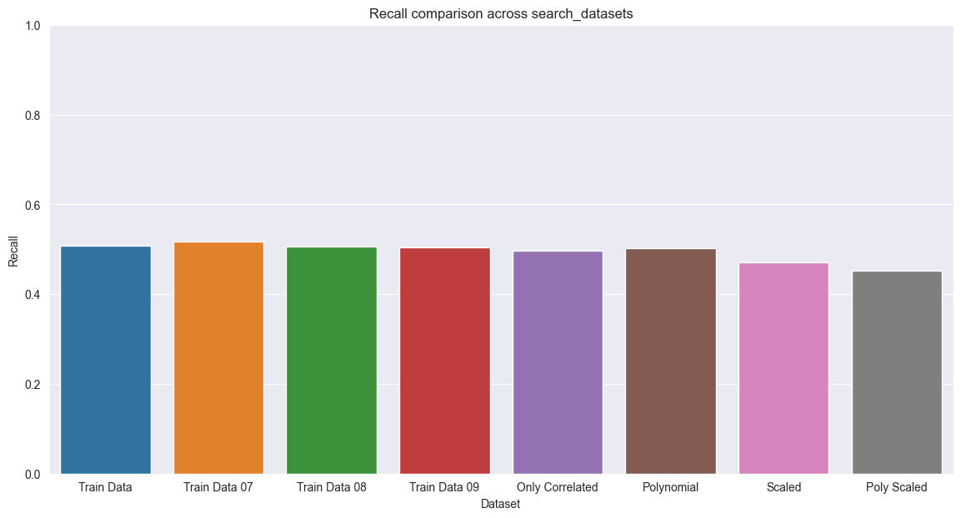

Neural Network

Slide 9
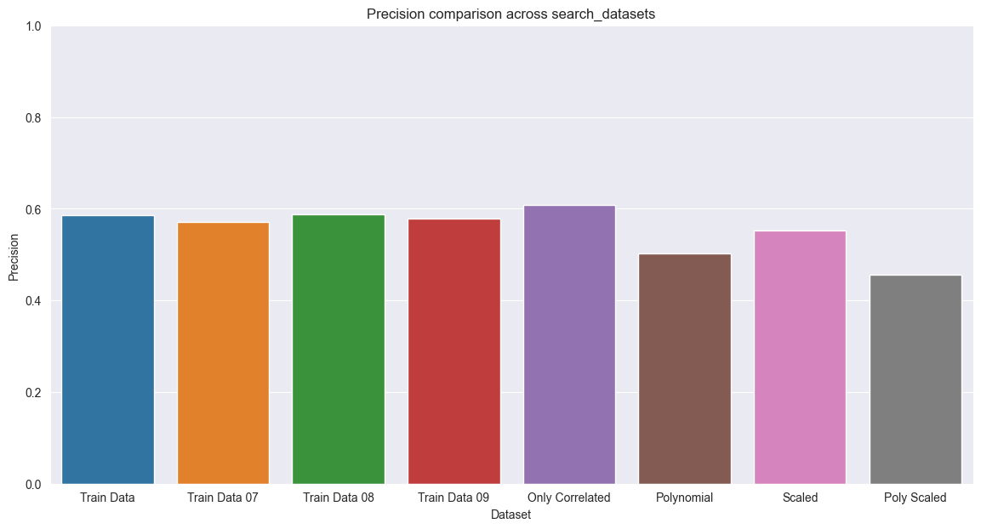
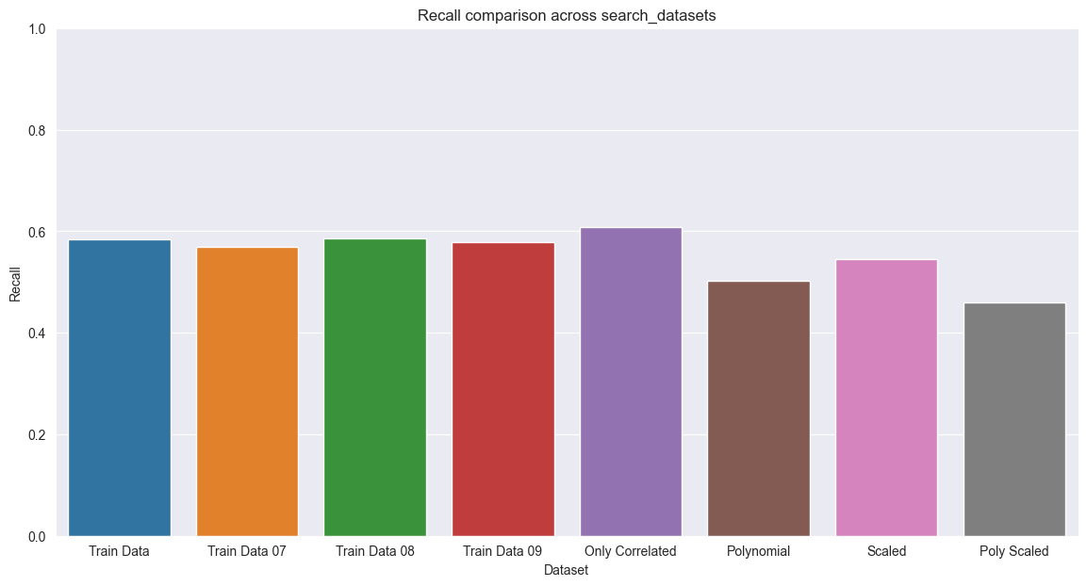

Decision Tree

Slide 10
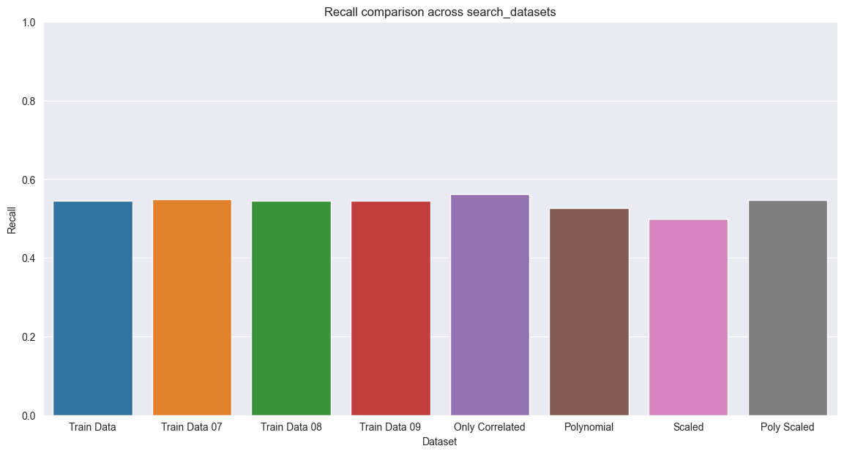


K-Nearest Neighbors

Slide 11
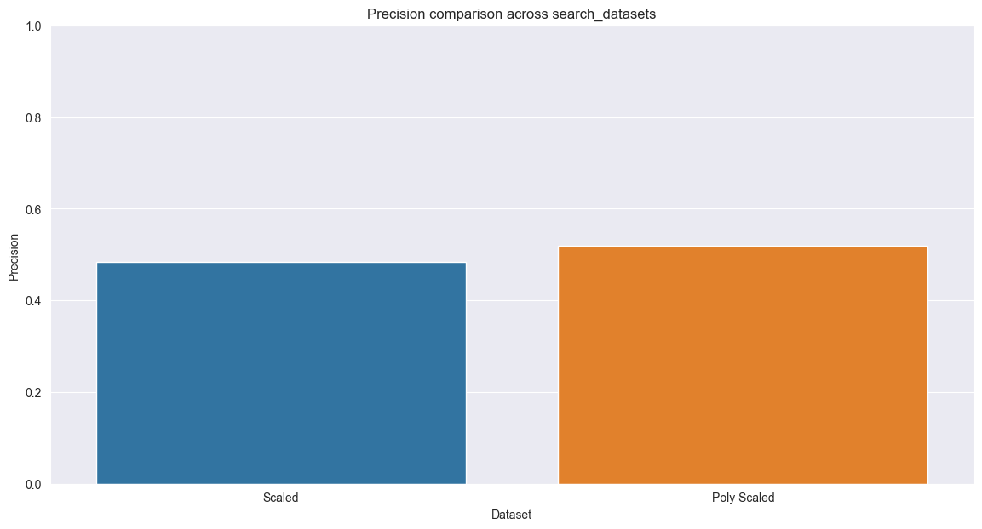


Support Vector Machine

Slide 12
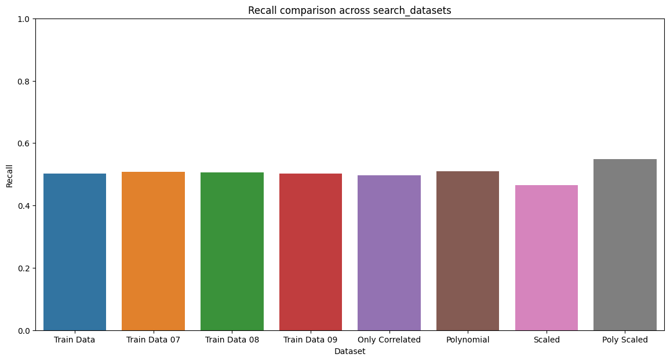
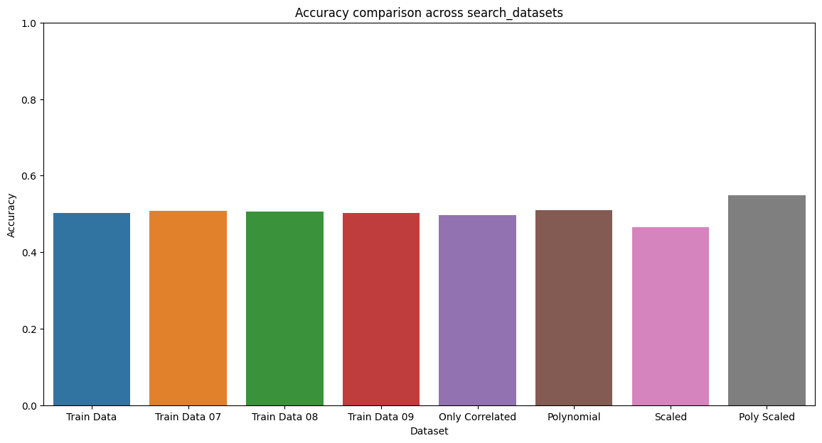
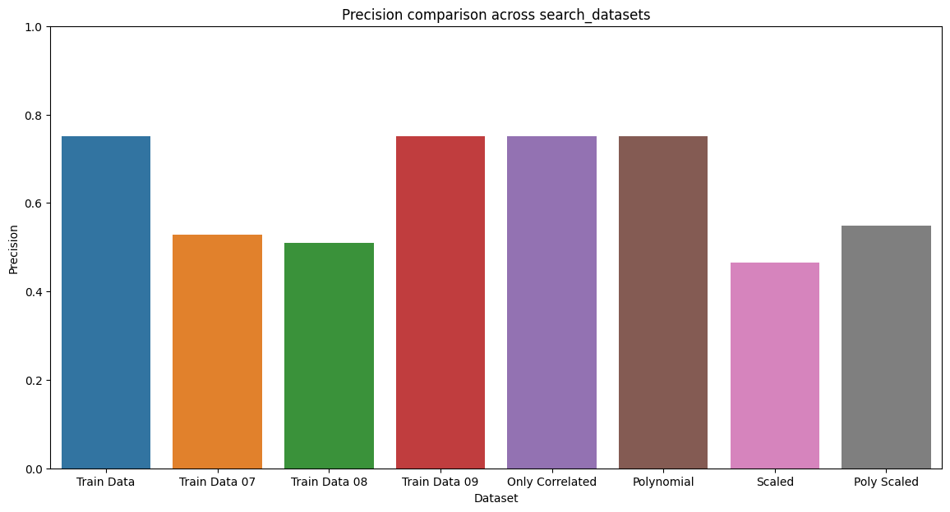
Stochastic Gradient Descent

